Slide 1
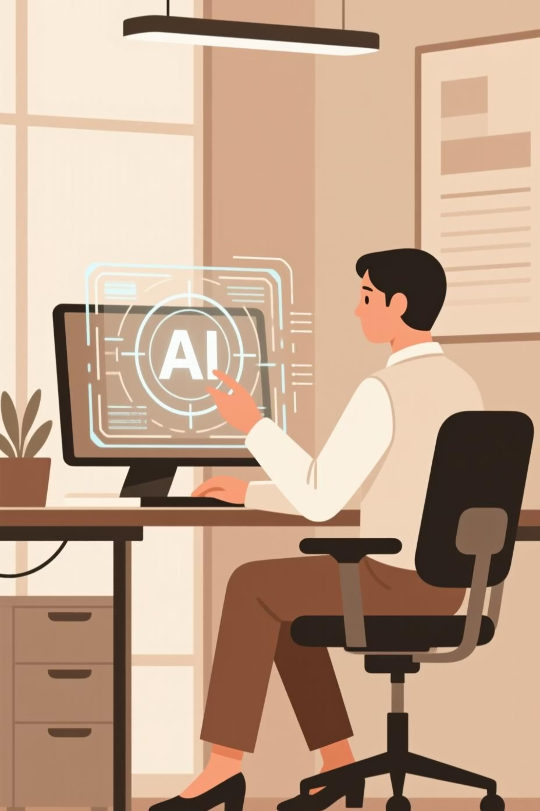
Building a Personal AI Practice
Module 6 — Approximately 60 minutes
Integrating AI into your daily personal, creative, and professional routines with responsibility and purpose.

Slide 2
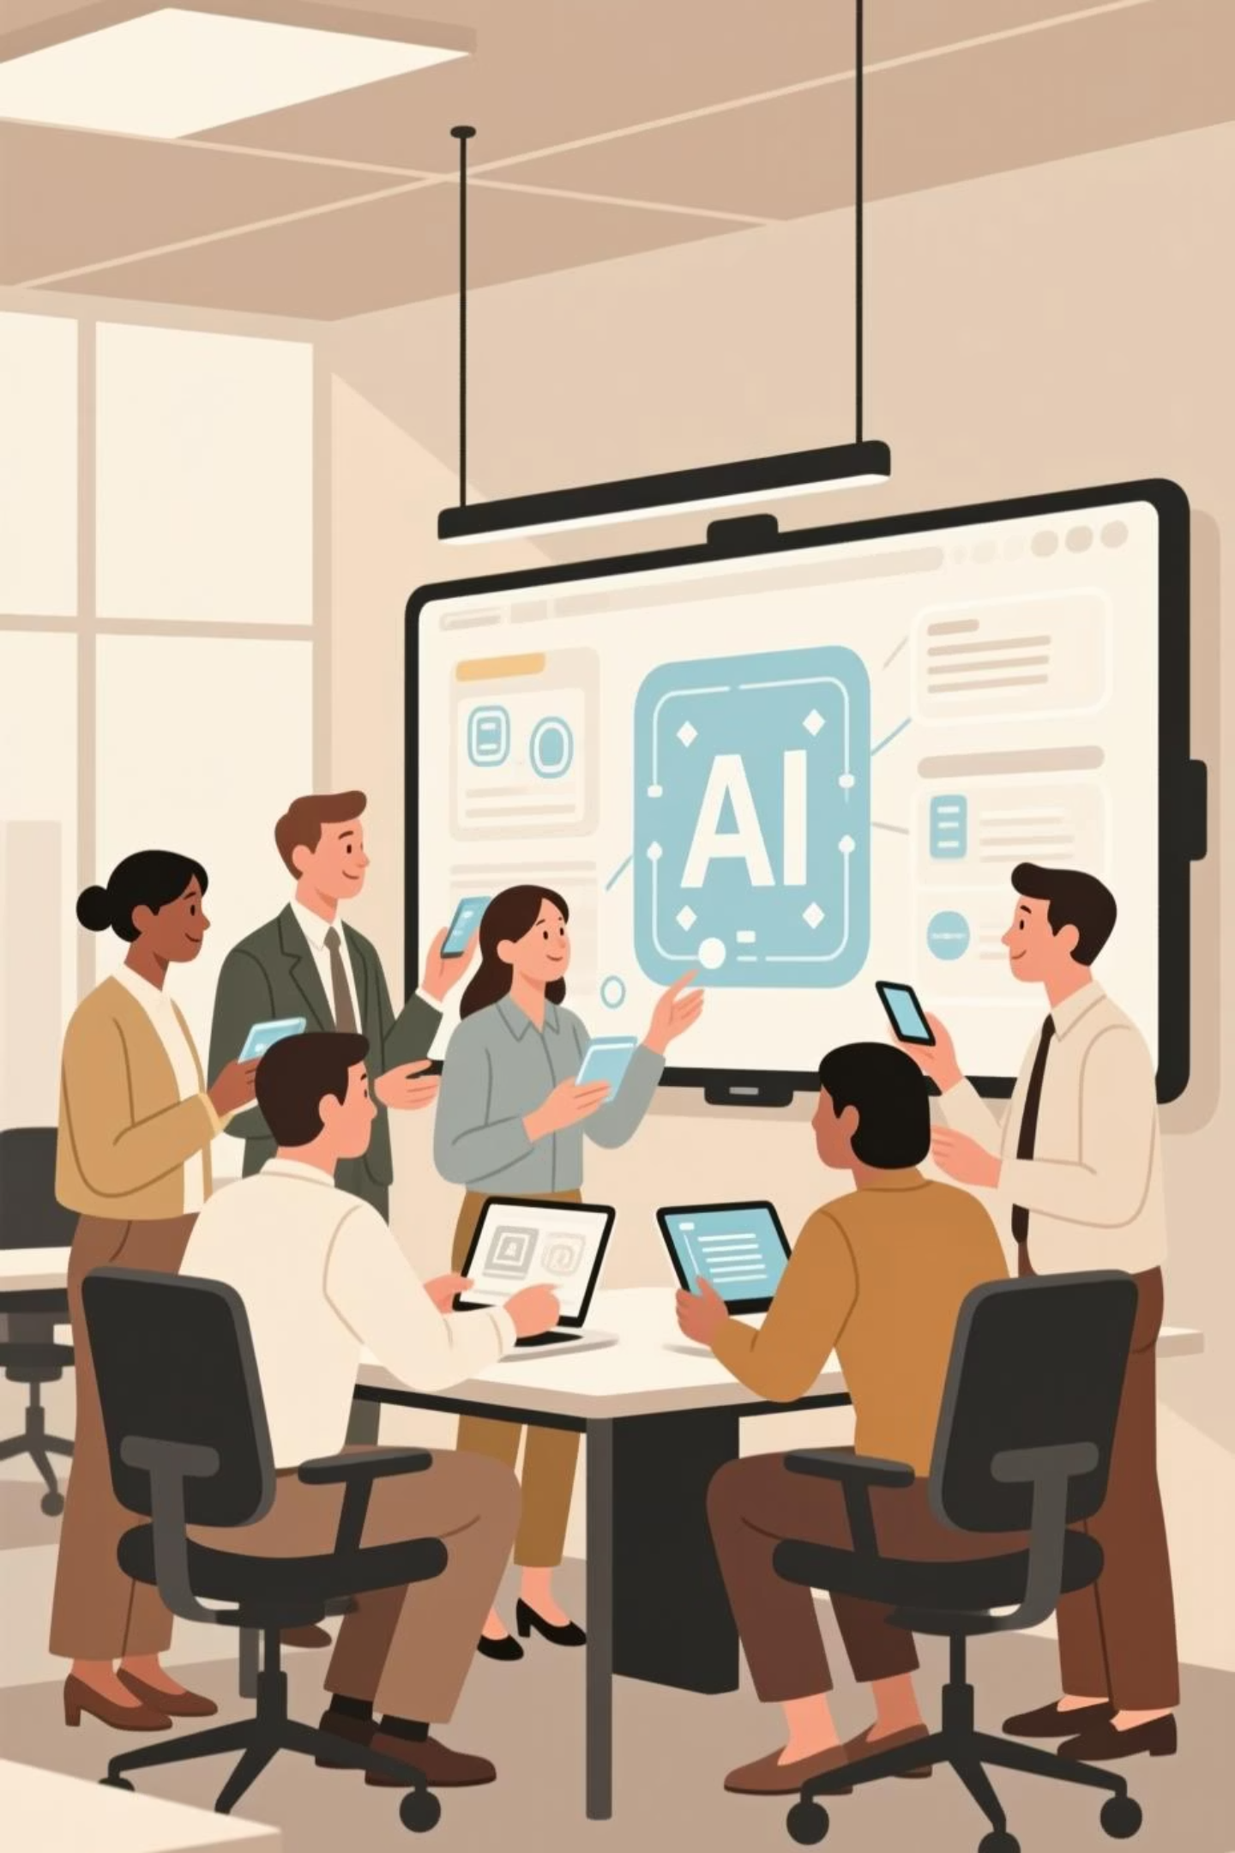
Your Goal
Equip yourself to integrate AI into personal, creative, and professional routines responsibly, effectively, and creatively.
This module bridges foundational skills with real-world application, empowering you to make AI a trusted collaborator in your everyday life.

Slide 3


How to Use AI Daily
AI is most valuable when used intentionally. It can support a wide range of activities, enhancing learning, productivity, creativity, and planning without replacing your decision-making or originality.
Learning Assistant
Summarize articles, explain complex concepts, create flashcards, and generate practice quizzes to deepen understanding.
Productivity Booster
Draft emails, outline reports, schedule reminders, and organize tasks to streamline your workflow.
Creativity Partner
Brainstorm story ideas, generate visual art, compose music, and plan marketing campaigns with fresh perspectives.
Planning & Organization
Build travel itineraries, budgets, project timelines, and workout schedules tailored to your goals.
Coding Helper
Suggest code snippets, debug errors, optimize logic, and explain programming concepts clearly.
Facilitator Tip: Ask learners which AI use would be most helpful for them today. Consider a live demo showing AI generating a meeting agenda or to-do list. Emphasize that AI augments human skills—your creativity and judgment remain central.

Slide 4

AI Appreciation Mindset
Cultivating the right mindset unlocks AI's full potential while maintaining responsibility and ethical awareness.
Curious
Skeptical
Creative
Explore features, experiment with prompts, and ask "what if?" to discover new possibilities.
Question outputs, verify facts, and watch for bias or errors to ensure accuracy.
Enhance original thinking rather than copying outputs blindly—let AI inspire, not replace.
Responsible
Collaborative
Consider ethical implications, privacy concerns, and fairness in every AI interaction.
Combine human judgment with AI speed, scalability, and pattern recognition for optimal results.
Facilitator Tip: Share an anecdote about a creative solution sparked by AI experimentation. Ask: "Which mindset quality do you want to strengthen, and why?" Consider a reflection activity where learners write one actionable step for cultivating that trait.

Slide 5

Final Challenge: Create an AI-Assisted Project
Apply everything you've learned by creating a personal project using AI as a collaborator. This hands-on challenge transforms theory into practice.
Project Ideas
Guidelines
Poem, short story, or essay
Human vision comes first. AI supports your thinking—it doesn't replace it.
Digital artwork, visual design, or multimedia
Study guide, summary, or research notes
Iterate creatively. Refine prompts, explore outputs, and combine suggestions.
Business idea, marketing plan, or project workflow
Personal productivity system (planner, schedule, habit tracker)
Reflect intentionally. Note what was helpful, surprising, or challenging.
How did AI enhance your creativity or efficiency?
Were there moments when AI misunderstood your instructions?
How could this approach be applied in work, learning, or hobbies?
Optional Extension: Small group showcase where learners share projects, discuss approaches, and highlight lessons learned.

Slide 6




Transition to Advanced AI
Where You Are Now
Generative AI
Agentic AI
You've learned to use AI as a collaborative tool in daily tasks, building foundational skills in prompting, iteration, and responsible use.
Creates original content—text, images, music, code—based on patterns learned from vast datasets.
Acts autonomously to complete tasks, make decisions, and execute actions with minimal human intervention.
Why This Matters
Understanding these advanced concepts allows you to:
Recognize new ways AI can amplify creativity and productivity
Identify risks and limitations before they become problems
Apply responsible collaboration principles to more powerful tools
"Imagine your AI could generate ideas on its own, or take actions like scheduling, sending messages, or organizing resources. How would this change the way you work?"
Facilitator Tip: Highlight continuity—"The skills you've developed (clarity, iteration, ethical awareness) apply to Generative and Agentic AI." Consider showing a short AI-generated content example, then illustrate how agentic AI could execute related tasks autonomously.

Slide 7

Module 6 — Facilitator Notes
Slide 14: Daily AI Use
Emphasize practical integration; show AI as a versatile, empowering tool that enhances rather than replaces human capability.
Slide 15: AI Mindset
Stress mindset development: curiosity, skepticism, creativity, responsibility, and collaboration as core competencies.
Slide 16: Final Challenge
Encourage project-based learning and iterative exploration. Allow time for reflection and peer sharing.
Slide 17: Transition
Set the stage for Module 7 by introducing advanced AI concepts (Generative + Agentic AI) as natural progressions.
Key Takeaways
AI is a tool for enhancement, not replacement
Mindset qualities maximize the benefits of AI
Intentional, iterative use develops skill, confidence, and insight
Practice prepares learners for advanced autonomous tools

Slide 8
Module 6 — Learner Outcomes
By the end of Module 6, learners will have developed essential capabilities for integrating AI into their daily lives.
Daily Integration
Responsible Mindset
Collaborative Practice
Integrate AI into daily life for learning, creativity, and productivity
Apply an AI appreciation mindset for responsible and ethical use
Use AI collaboratively and iteratively to refine outputs
Reflective Learning
Future Readiness
Reflect on experiences and outcomes to improve practice
Understand how these skills prepare for Generative and Agentic AI
Ready to advance your AI journey

